Slide 1
Introduction to A/B testing
Isaya Acevedo and Lichen Yang

Slide 2
Overview
Intro to A/B testing
Phases of A/B testing
Metrics
Dataset Description
Hypothesis Formulation
Statistical Test
Conclusion / Shortcomings

Slide 3
Intro to A/B testing
Definition: A/B testing is a form of hypothesis test, at its most basic, compares two versions of something to figure out which one performs better.
A/B testing is a randomized controlled experiment where two versions (A and B) are compared to determine which one performs better based on a chosen metric.
It’s commonly used in product development, especially in tech companies, to evaluate changes before wide release.
It involves hypothesis testing, where Version A (control) is compared against Version B (treatment) to assess improvements.
Decisions rely on statistical significance, controlling Type I (false positive) and Type II (false negative) errors.
Often involves multiple metrics, such as success, guardrail, deterioration, and quality metrics, each serving different purposes.

Slide 4
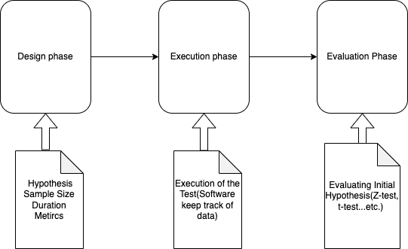
Phases of A/B testing
Design the A/B testing
Specify a range of parameters
Execute the A/B testing
Deploy the two variants in a live system
Evaluation
Testing the original hypothesis

Slide 5
Metrics
Success metrics: Metrics where you expect improvement (e.g., more clicks, higher conversion rates).
Guardrail metrics: Metrics you don’t want to worsen, like performance or error rates, ensuring no negative impact.
Deterioration metrics: Metrics that must not degrade (e.g., increase in app crashes).
Quality metrics: Verify the experiment’s integrity, such as testing for sample ratio mismatch (SRM) or ensuring no bias in traffic assignment.

Slide 6
Dataset Description
The dataset contains performance metrics from two marketing campaigns executed by the company: the control campaign and the test campaign. Each campaign's data spans over 30 days, capturing daily activities and user interactions.
Features include date, amount spent on the campaign per day, number of ads displayed, number of unique users who saw the ad, clicks on the website link from ads, and number of users who searched the website after clicking the ad.

Slide 7
Success Metrics
Purchase Rate (Impressions to Purchases)
Measure the percentage of users who make a purchase after viewing the content or ad
This metric helps measure the overall success of your impressions at driving actual sales
Purchase Rate = (Number of Purchases / Number of Content Views) * 100
Conversion Rate
The percentage of visitors who take a desired action, such as making a purchase after clicking on the website
Helps assess how well your site converts visitors into customers.
Conversion Rate = (Number of Purchases / Number of Website Clicks) * 100

Slide 8
Guardrail Metrics
Add-to-Cart Rate
Percentage of users who add items to the cart after viewing content
Add-to-Cart Rate = (Number of Add to Cart / Number of Content Views) * 100
Bounce Rate
Percentage of users who navigate away after viewing only one page
100 - (Number of Website Clicks / Impressions) * 100
Page Load Time
Average time it takes for a page to load, ensuring performance isn't degraded

Slide 9
Deterioration Metrics
Conversion Rate Over Time
Monitor changes in conversion rate throughout the test period
Deterioration = ((Initial Value – Final Value) / Initial Value) * 100
Click-Through Rate (CTR)
Measures how many users clicked on your website link after seeing it (based on impressions)
Indicates how effective your ad or content is at driving traffic to the website
CTR = (Number of Clicks / Number of Impressions) * 100

Slide 10
Quality Metrics
Sample Ratio Mismatch
Checks the discrepancies in the expected 50/50 split between control and treatment groups
Uses the Chi-square test to compare the observed and expected sample sizes

Slide 11
Hypothesis each group of metrics
Definition: minimum detectable effect (MDE) is the effect size used for Success Metric when designing the experiment
Definition: non-inferiority margin (NIM) is the tolerance level of regression used in the non-inferiority tests used for guardrail metrics.
Success Metrics (right-tail):
H0: δ ≤ 0
HA: δ > 0, δ = MDE
Guardrail Metrics (right-tail):
H0: δ ≤ −NIM,
HA: δ > −NIM
Deterioration Metrics (left-tail):
H0:δ ≥ 0,
HA: δ < 0
Quality Metrics: Hypotheses of the quality tests are left out.

Slide 12
Statistical Test
T-Test for Means:
Determines if there's a statistically significant difference between the means of the two groups (control and test) for continuous metrics like purchase rates or conversion rates
T-statistic measures the size of the difference relative to the variability in the data
Chi-Square Test for Sample Ratio Mismatch
Checks whether the observed allocation of users into control and test groups matches the expected ratio ensuring randomization integrity
Chi-Square quantifies the discrepancy between observed and expected frequencies
Cohen's d Value (Effect Size Interpretation)
Measures the magnitude of the difference between two groups, providing insight into practical significance beyond p-values

Slide 13
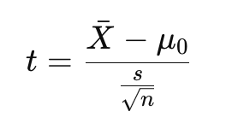
One-sided T-test
T-statistic Calculation:
Xˉ = mean of the sample (e.g., test group metric)
μ0 = mean under the null hypothesis (e.g., control group metric)
s = sample standard deviation
n = sample size
Right-tailed p-value: Probability of getting a t-statistic ≥ tobs.
Left-tailed p-value: Probability of getting a t-statistic ≤ tobs.

Slide 14
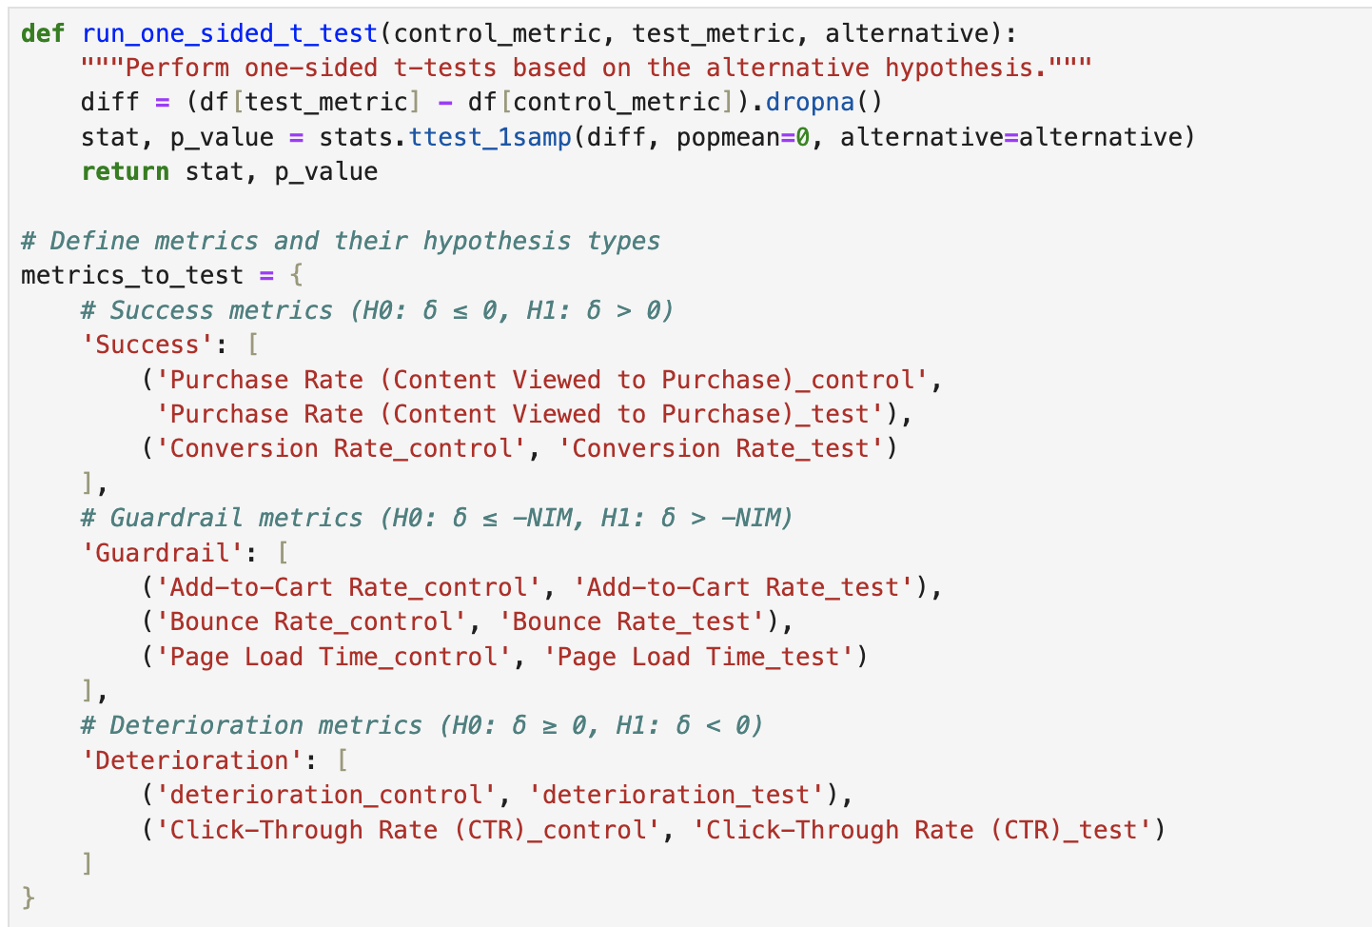
T-test Code Setup:

Slide 15
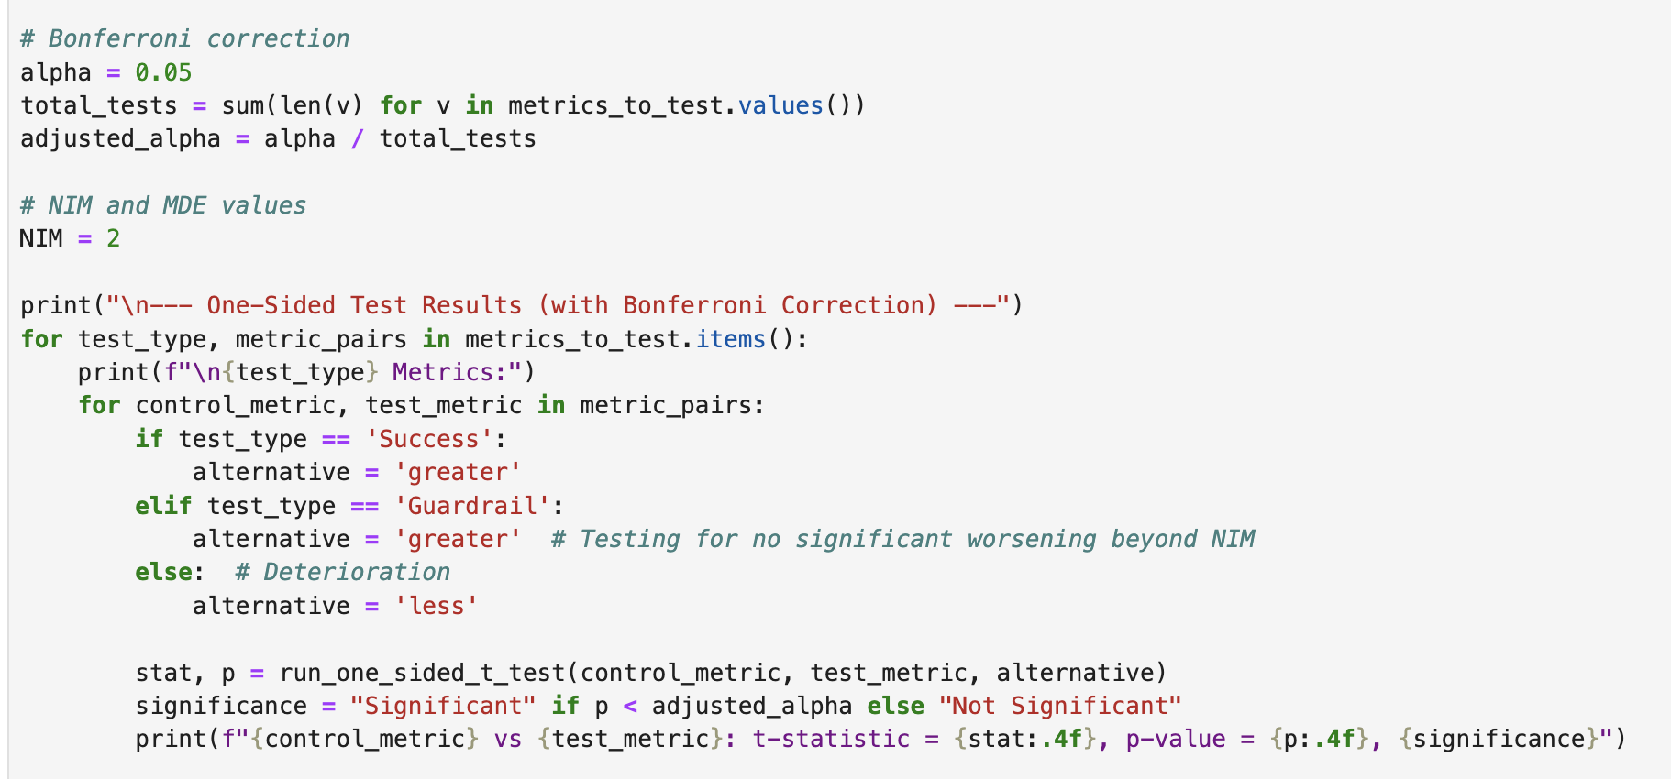
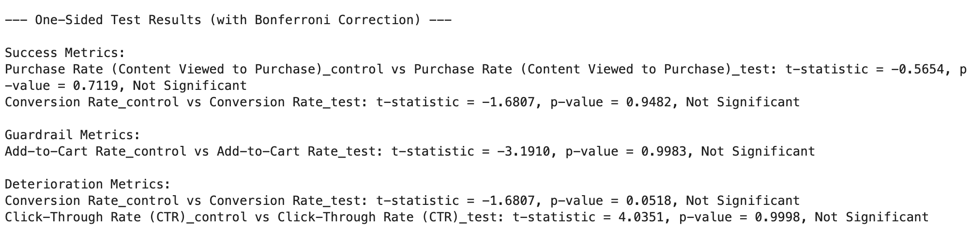
Bonferroni Correction
used to control the family-wise error rate (FWER) when performing multiple hypothesis tests.
FWER = 1−(1−α)^m
Bonferroni correction addresses the increasing false positive rate by dividing the original significance level α by the number of tests m.
αcorrected = α/ m

Slide 16
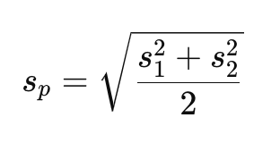
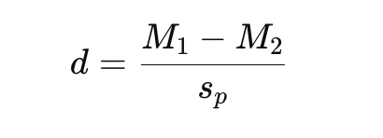
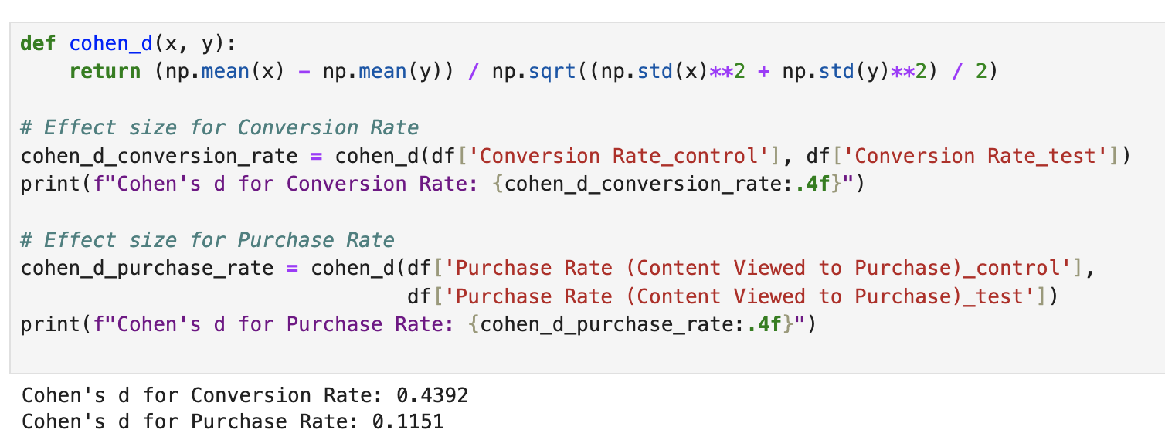
Cohn's d
Mathematical formula:
Effect size (Cohen's d) provides a standardized measure of the magnitude of the difference between the control and test groups. Cohen's d helps quantify the practical significance of your A/B test.
Conversion Rate: 0.4392 indicates a medium effect size. It suggest a moderate practical difference in conversion rates between the control and test groups, though not statistically significant based on p-value
Purchase Rate: 0.1151 indicates a small effect size, indicating only a minor difference in purchase rates between the groups

Slide 17
Bayesian Analysis
Incorporate prior knowledge and update beliefs with new data
Beta Distribution
Used for Modeling conversion rates
Parameters:
α = Number of success + prior successes
β = Number of failures + prior failures
Posterior Probabilities
Posterior distribution combines prior and likelihood
Probability of Improvement
Calculated by sampling from posterior distributions
Probability that the treatment is better than control

Slide 18
Shortcomings
Multiple-testing problem: Testing many metrics increases the chance of false positives. Solutions include multiple-testing corrections (e.g., Bonferroni correction), but this may reduce the power of tests.
Guardrail and deterioration metrics: Sometimes, changes improve primary metrics but negatively affect secondary ones. Including proper guardrail and deterioration metrics in the decision rule can mitigate this risk.
Sample size issues: Small sample sizes may lead to underpowered tests, increasing Type II errors (false negatives). Power analysis should be done before running the experiment to ensure enough data .
Generalizability of results: A/B tests can be biased if the test population doesn’t represent the entire user base. Solutions include ensuring random and representative sampling or correcting for known biases.

Slide 19
Bibliography
Federico Quin, Danny Weyns, Matthias Galster, Camila Costa Silva. A/B Testing: A Systematic Literature Review, 9 Aug. 2023, arxiv.org/pdf/2308.04929
Mårten Schultzberg, Sebastian Ankargren and Mattias Frånberg. Risk-Aware Product Decisions in A/B Tests with Multiple ..., 18 Feb. 2024, arxiv.org/pdf/2402.11609

